Slide 1

Variable Changes in Attendance at Wrigley Field
2015 – 2019
By: Scott Duncan, Sam Ettenson, Calvin Brown, Tiffany Christmas
Notes:
(Calvin)

Slide 2
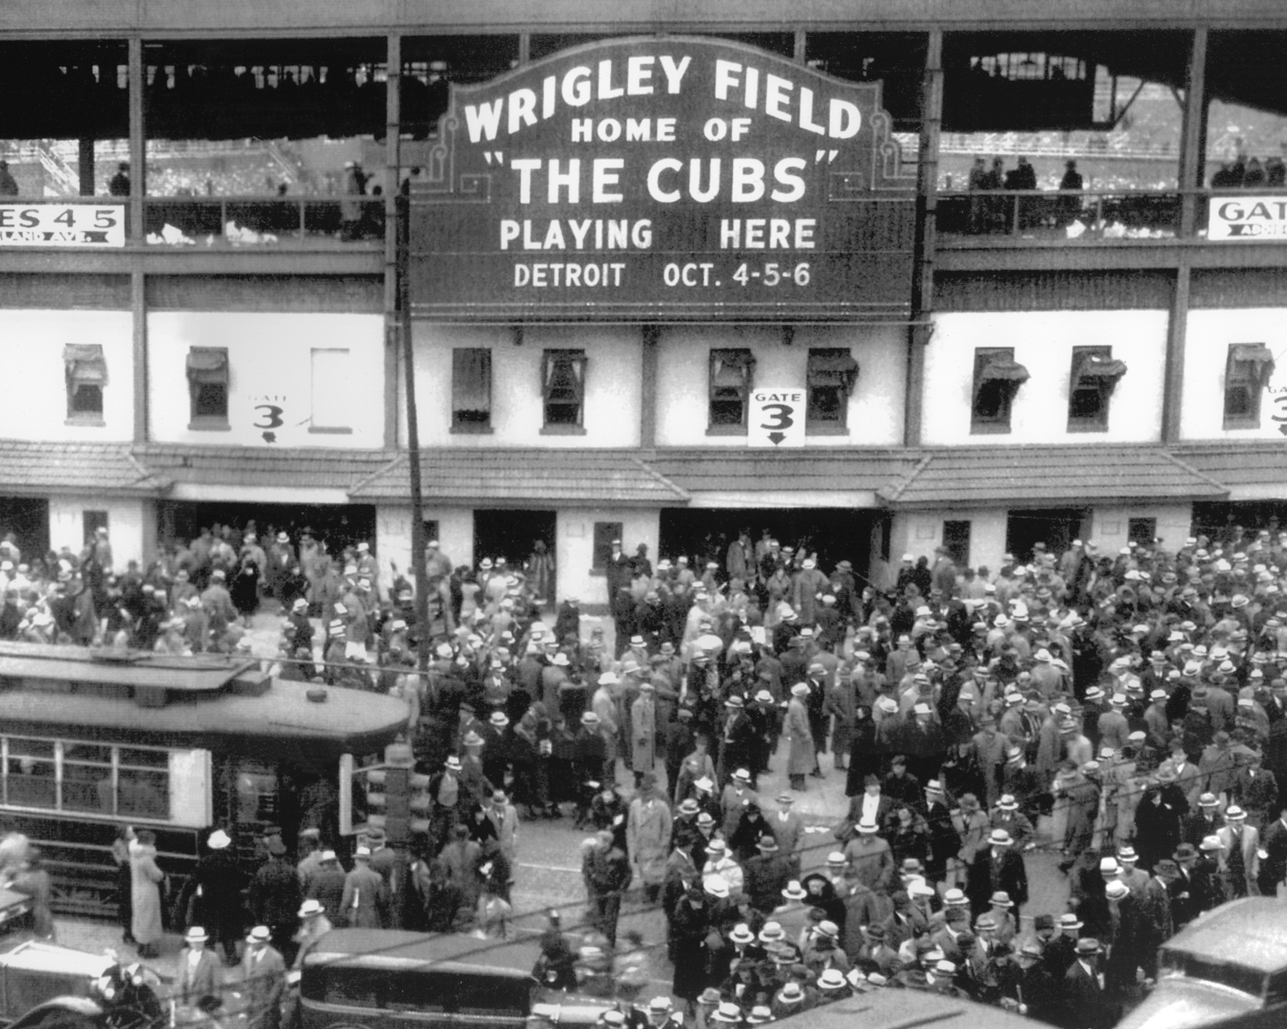
GO CUBS GO!
How is attendance at Wrigley Field affected when considering…
Weather
Home Team Performance
Attendance due to Opponent
Day of the Week, Time of Day, and Year
Notes:
(Calvin)

Slide 3
What Data is Needed?
MLB Game Summary Statistics
Attendance Records per Game
Weather Data
Historical Data
Crime Data
Insert a snip of the pandas data frame column headers
Notes:
(Sam)

Slide 4
Cleaning & Exploring
CSV/Excel for MLB Statistics
Formatting
Delimiting
Excel Import
API Call
JSON
Change Time interval of calls per day to 1x versus 8 different (3 hour increment) times
Pulled Relevant Dictionaries
Merge Data
Groupby Date
This allowed us to pull information for home games specifically
Weather data had 900+ rows, MLB game dates were only 404
Notes:
(Tiffany)

Slide 5
***SNIP OF DATA CLEANUP***

Slide 6
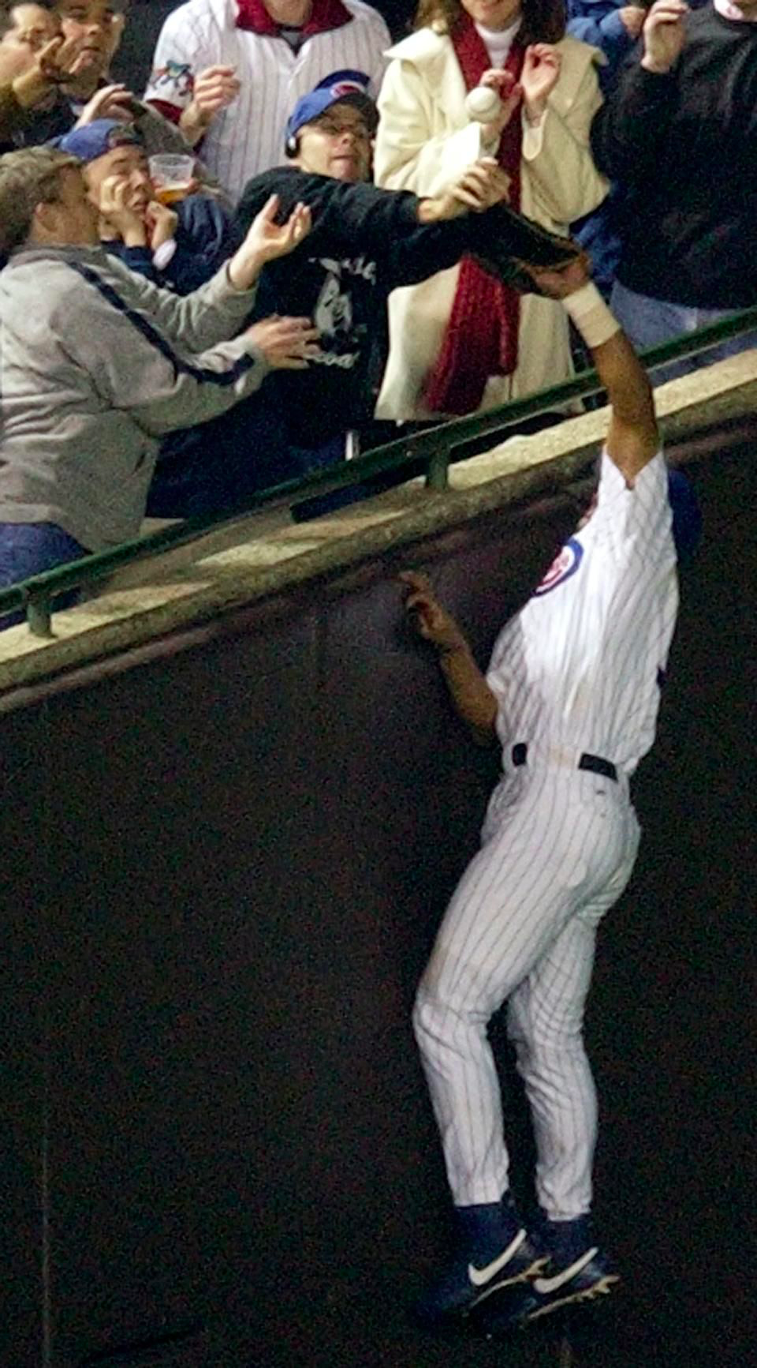
The Bartman Phenomenon
Weather API calls
Finding a free weather API
Only able to pull 35 days of information at a time
30 different API calls needed to compile all dates needed
Append every API call into one data frame
Code formatting to merge dictionaries
MLB Statistics
Finding statistical data on individual attendance for each game from 2015 to 2019 versus average only
Wanted to look up crime data versus attendance
Time constraints in data presentation
Finding relevant crime statistics
Felony
Misdemeanor
Exact Location of crime
Notes:
(Scott)

Slide 7
“It’s a Bee – yoo –tiful Day”
Hypotheses
Describe the questions you asked and why you asked them
Describe whether you were able to answer the questions to your satisfaction
Summarize your findings

Slide 8
Weather Data Analysis
Notes:
If I had more time on my weather analysis…
Summarize Conclusion: Summary about what the data yielded and visualization

Slide 9
Fly the “W” Every Day

Slide 10
Team Performance Analysis
Notes:
If I had more time on my weather analysis:

Slide 11
Cubs Win! Cubs Win!

Slide 12
Opponent Attendance Data Analysis
Notes:
If I had more time on my weather analysis:

Slide 13
Cubs Show Up Day or Night

Slide 14
Attendance Based on Day and Year Analysis
Notes:
If I had more time on my weather analysis:

Slide 15
CUBS WIN
Questions?

Slide 16
References

